Slide 1
Connecting Watson to SPSS Modeler
Dr. Olav Laudy Nov 2014

Slide 2
Context and objective
In Bluemix (https://console.ng.bluemix.net/), Watson components are made available as part of the IBM analytics cloud offering.
One of those offerings is IBM Watson™ Personality Insights
Personality Insights enables clients to derive insights from social media, enterprise data, or other digital communications. The service uses linguistic analytics to extract cognitive and social characteristics, including Big Five personality, values, and needs, from text. The results from Personality Insights can help businesses to understand their clients' preferences and improve customer satisfaction by anticipating customer needs and recommending the next best actions.
IBM SPSS Modeler can use the results from Personality Insights as additional predictors in machine learning models.
An extension was developed to pull Personality Insights results from Bluemix into IBM SPSS Modeler.
This presentation demonstrates and documents the approach.

Slide 3
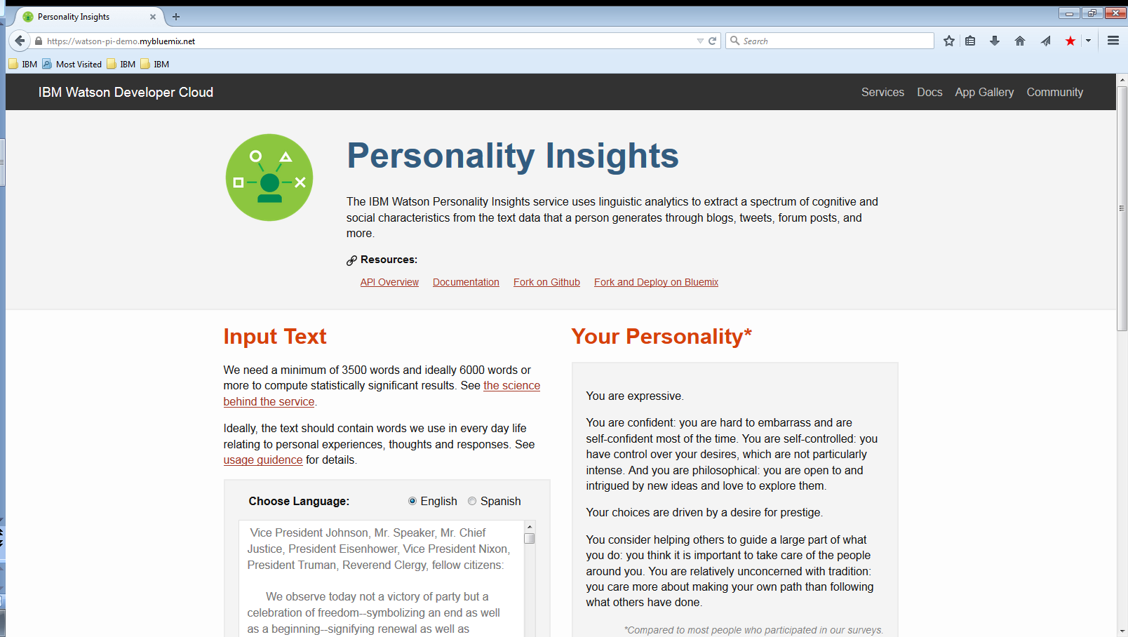
Web based demo @ http://watson-pi-demo.mybluemix.net/

Slide 4



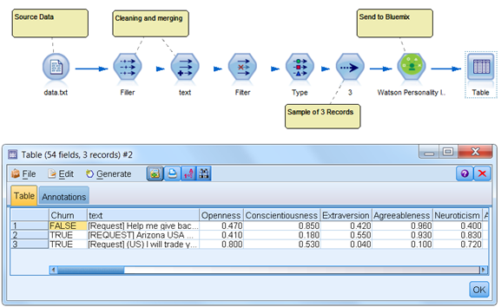
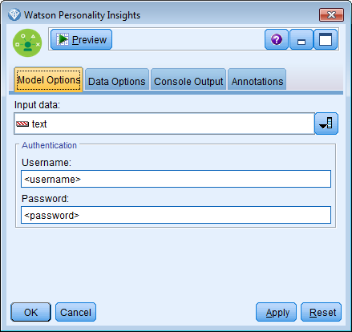
Getting results into IBM SPSS Modeler
Per row request with text
Answer with profile
Modeler client
Bluemix Front-End
Watson Back-End
Modeler Demo Stream
Dialog to Connect to Personality Insights

Slide 5
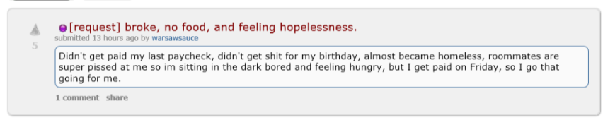
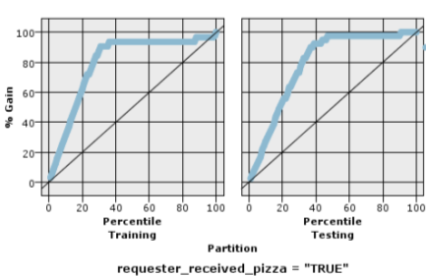
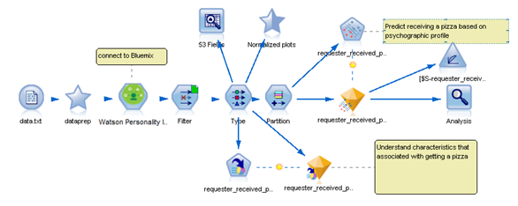
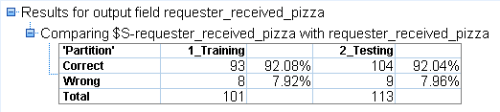
Modeling Experiment
The dataset contains 241 textual requests for pizza from the Reddit community Random Acts of Pizza (http://www.reddit.com/r/Random_Acts_Of_Pizza/) together with their outcome (successful/unsuccessful).
The task is to build a model to predict which requests will receive a cheesy (but sincere!) act of kindness.
For the purpose of the demonstration, only the outcomes of the Personality Insights are used.
Example of a data record
Results from using Personality Insights outcomes

Slide 6
Appendix
Making the demo work
Installing the extension in SPSS Modeler
Starting with Bluemix
Setting up Bluemix
Connecting to Bluemix
Creating the R component
More info

Slide 7
Installing the Extension in IBM SPSS Modeler
Installation Instructions
Download the extension
Close IBM SPSS Modeler. Save the .cfe file in the CDB directory, located by default on Windows in "C:\ProgramData\IBM\SPSS\Modeler\16\CDB" or under your IBM SPSS Modeler installation directory. (ProgramData is a hidden folder that can be reached by typing the path in Windows Explorer)
Restart IBM SPSS Modeler, the node will now appear in the Field Ops palette.
Requirements
Modeler can connect to the internet
R plugin is installed
ftp://public.dhe.ibm.com/software/analytics/spss/documentation/analyticserver/1.0/English/IBM_SPSS_Modeler_Essentials_for_R_Installations_Instructions.pdf
Two R packages are required - install automatically as part of first run
‘jsonlite’ – author: Jeroen Ooms, Duncan Temple Lang, Lloyd Hilaiel
https://cran.r-project.org/web/packages/jsonlite/index.html
‘httr’ – author: Hadley Wickham
https://cran.r-project.org/web/packages/httr/index.html
Note that the Personality Insights requires AT MINIMUM 100 words to give output.
Results will be $null otherwise
Make sure there are no “\” in the data (including carriage return such as \r\n)

Slide 8
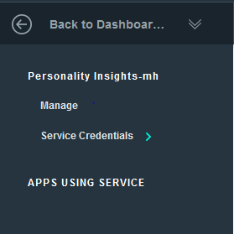
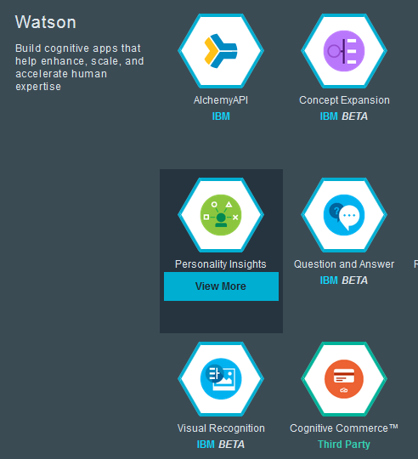
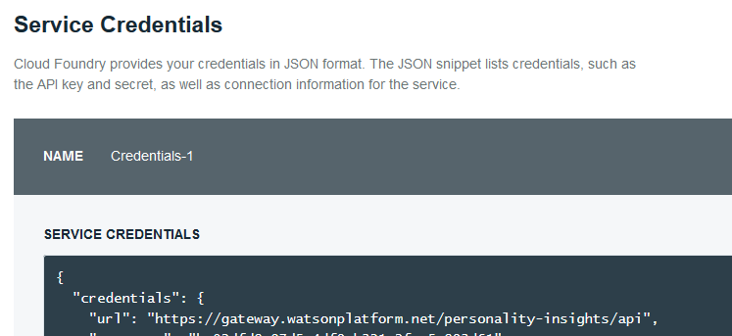
Setting up Bluemix
Go to https://console.ng.bluemix.net/ and make a (free) account & login
Add a service (“Personality Insights”)
Click “Service Credentials” to get your connection details

Slide 9
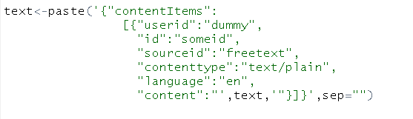
Analyzing the R Component
R code has the following parts
Appending the modelerDataModel with the variables that will be coming from Bluemix
Specifying the connection details
Creating the JSON object to send to Bluemix
Posting to Bluemix
Pulling the right data from the response and add it to the modelerData
Steps to view full R script:
In SPSS Modeler, click on Tools → Custom Dialog Builder for R..
In the pop-up dialog click File → Open Installed (after you have installed the extension)
Scroll to find WatsonPersonalityInsights
This will open the dialog builder for the extension, to see the R code click Edit → Script Template
From here you can review the script or copy and paste it into your preferred IDE

Slide 10
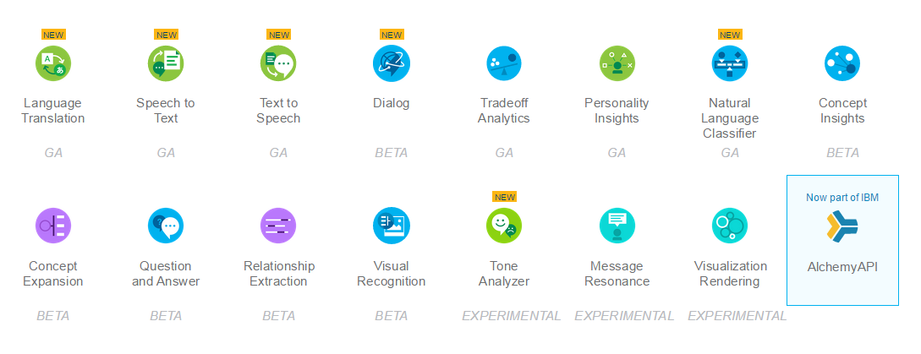
More info
Examples for Personality Insights
http://www.ibm.com/smarterplanet/us/en/ibmwatson/developercloud/doc/personality-insights/
Other available Watson services

